Slide 1
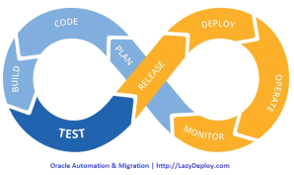
RADUGA
E-Business Suite Explorer

Slide 2
Explore Oracle and E-Business Suite objects
Manage and deploy development projects
Migrate developments between environments
Compare Oracle objects
Control versions
Save deployment history
Programmer Database Objects EBS Entities Media Scripts Business Events Framework Messages Workflows BI/XML Publisher Templates/Definitions/Files Discoverer Reports/Folders/Business Areas/Item Classes Trace Files Apex Applications/Workspaces Apache/OACORE/CM Restart Implementer Application Users Responsibilities Data Load Menus Messages | DBA Locked Objects Locks Tablespaces Users Trace Files Environment Status Monitoring Concurrent Sessions/Log Files User Sessions Application Log files Printers FRD Trace Search files Client Performance Analyzer Project Manager Projects Deployments/Approvals Reports: Development Projects Deployment Details Custom Objects Migration
Full documentation can be found at: https://www.lazydeploy.com/

Slide 3
Audience:
Oracle Applications Developers
Database Administrators
Project Managers

Slide 4
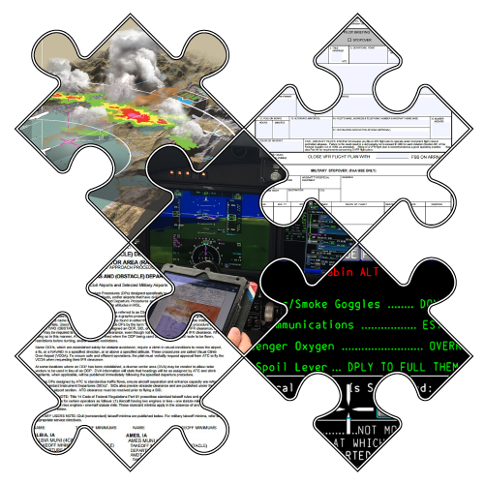
E-Business Suite infrastructure can be very complex…

Slide 5

Our goal is to simplify its access

Slide 6
Headaches: Their Causes & How to Get Rid of Them
Where is my development?
Do we have a map of all custom objects?
Who changed the object and when was it changed?
Who ran over my development?
The environment was refreshed. Where are my objects?
How can I roll back the changes?
Review is coming… Do we have a custom objects report?
Do we have a version control system?
How can I find and compare custom objects?
How long will it take to transfer 400 framework personalizations?
Do we have a backup?

Slide 7
Main Raduga Features

Slide 8
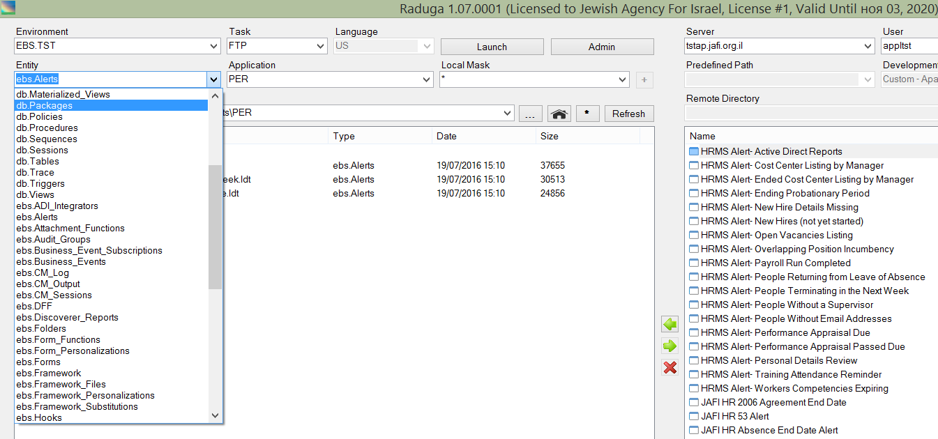
Object Explorer
There are dozens of Oracle Applications and Database entities you can explore using Raduga. It’s a matter of just one click…

Slide 9
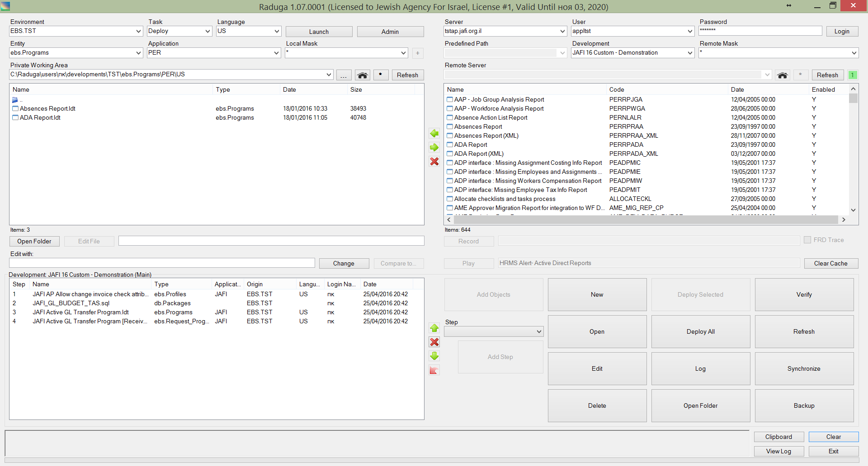
Object Migration
Drag items to your development project and deploy them in any environment. It’s a matter of just one click…

Slide 10
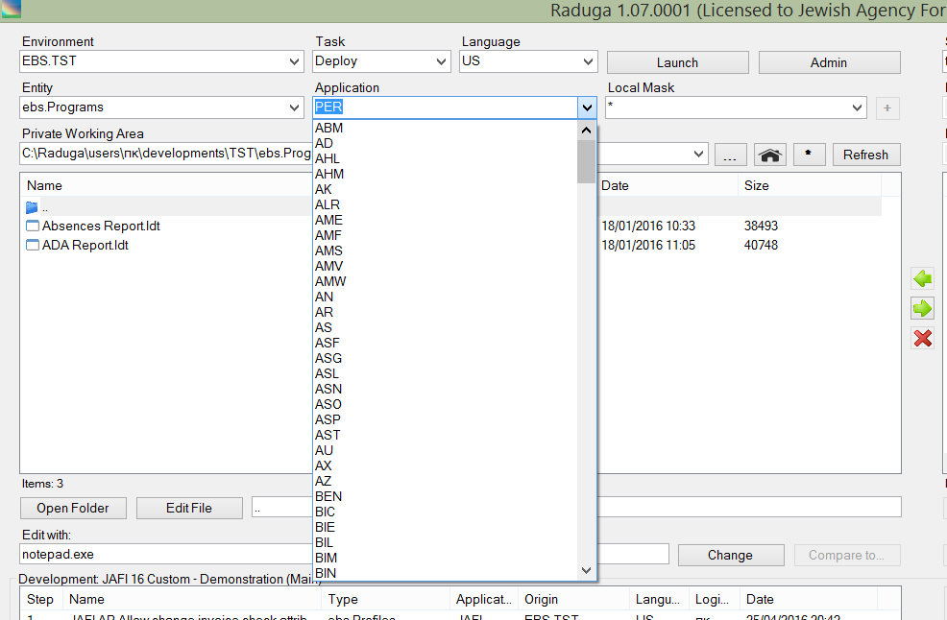
Intuitive Navigation
Choose Environment, Application, Language and Entity. Raduga will take you there. It’s a matter of one click…

Slide 11
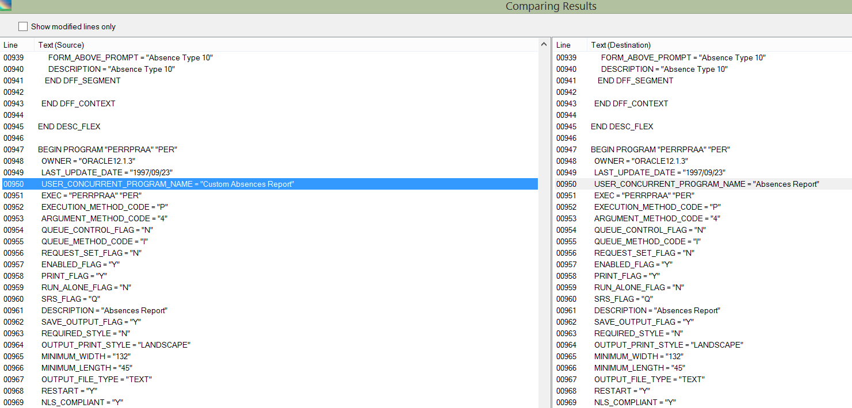
Easy Object Comparison
Compare local and server objects. It’s a matter of one click…

Slide 12
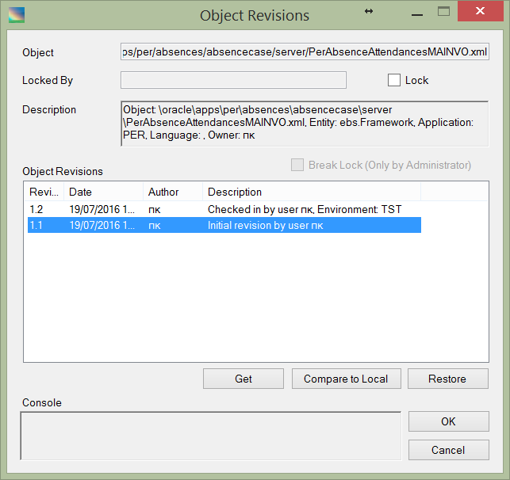
Version Control and Deployment History
See an object’s change history. Compare versions; restore a previous version. It’s a matter of just one click…

Slide 13
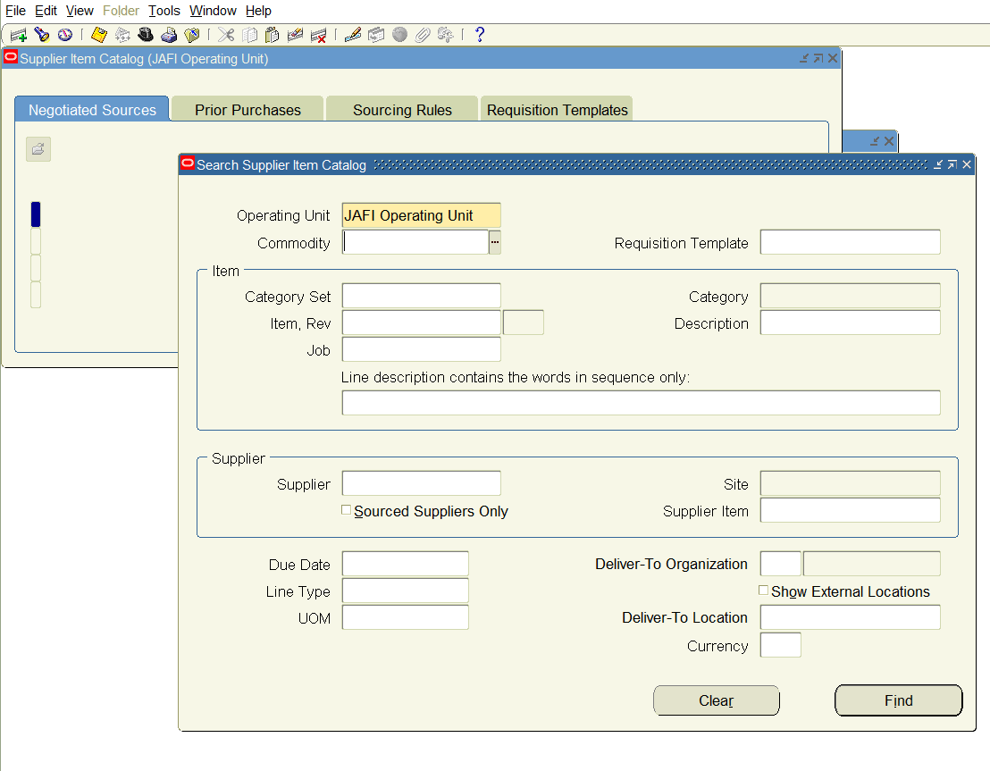
Data Loading
Record DataLoader files and upload them to any environment.

Slide 14
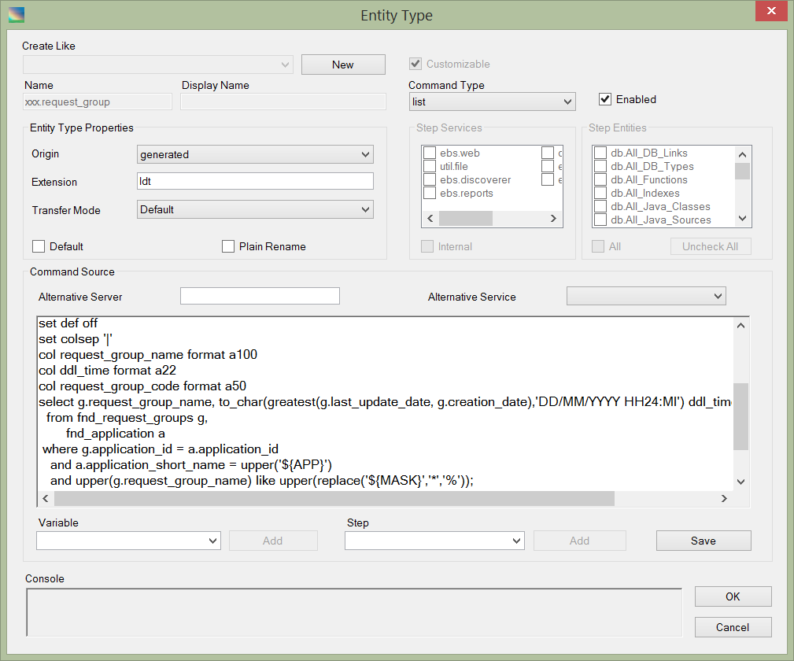
Easy Customization
Create your own objects and entities specific to your company.

Slide 15
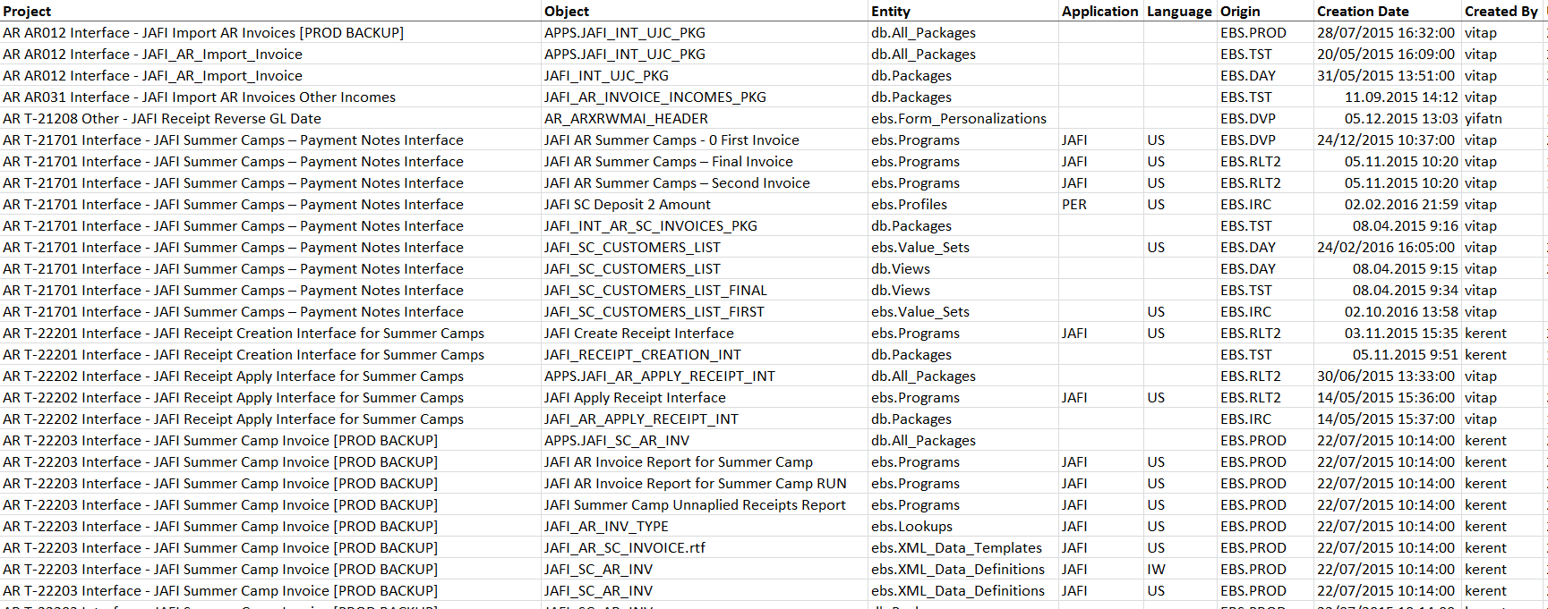
Reporting
A list of all custom objects? No problem. It’s a matter of just one click…

Slide 16
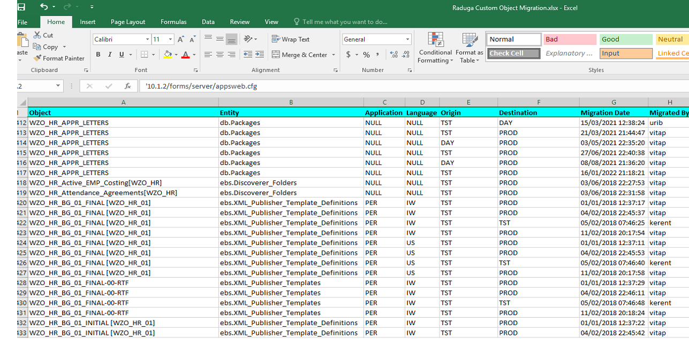
Reporting
A list of custom object migrations? No problem. It’s a matter of just one click…

Slide 17
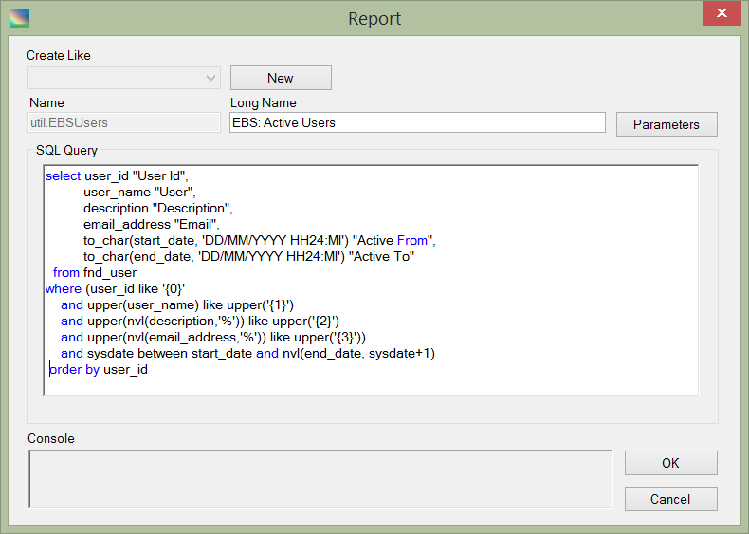
Reporting
Create your own custom report.

Slide 18
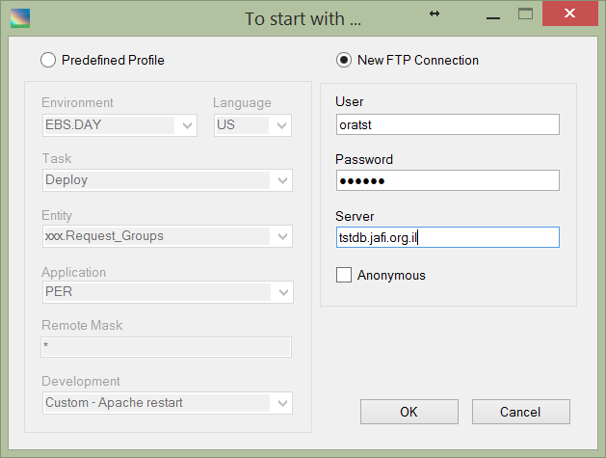
File Transfer
Use Raduga as a simple FTP client. The command line interface lets you use Raduga for batch files.

Slide 19
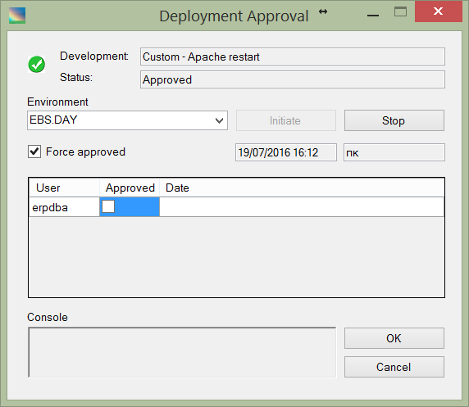
Development Project Approval
No project will be deployed in the environment without approval. It’s a matter of just one click…

Slide 20
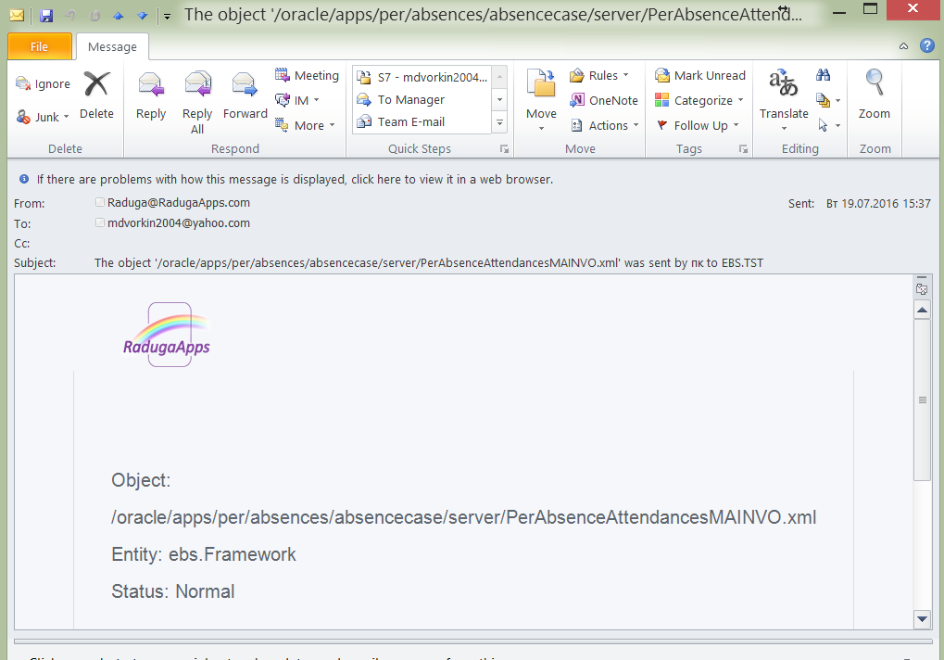
Notifications
Subscribe to Raduga events to get an email notification about any action performed by Raduga.

Slide 21
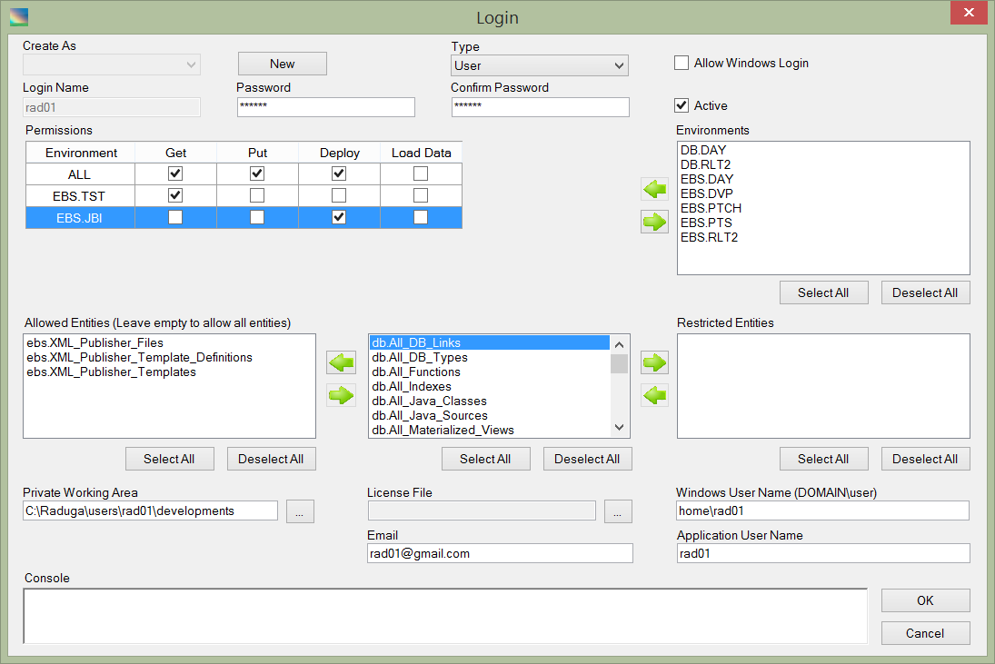
Security
Grant each Raduga user only the necessary permissions on environments, entities and actions.

Slide 22
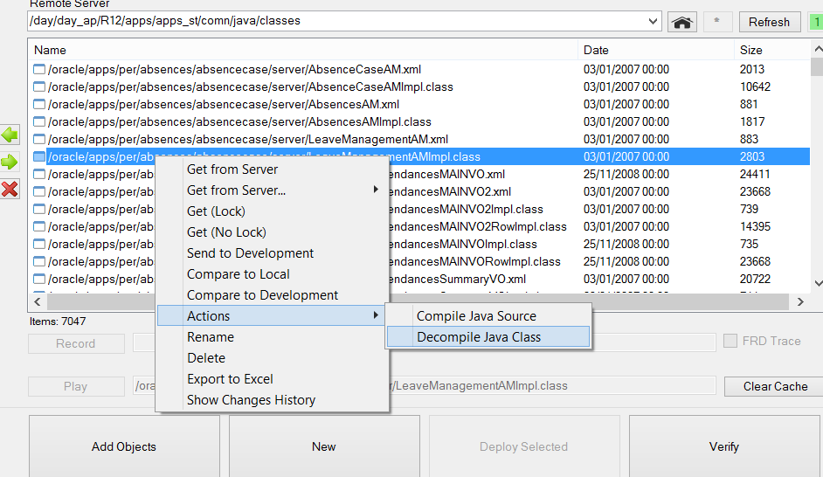
Custom Actions
Define custom actions, like “Compile form”or “Decompile Java class”, on Raduga entities.

Slide 23
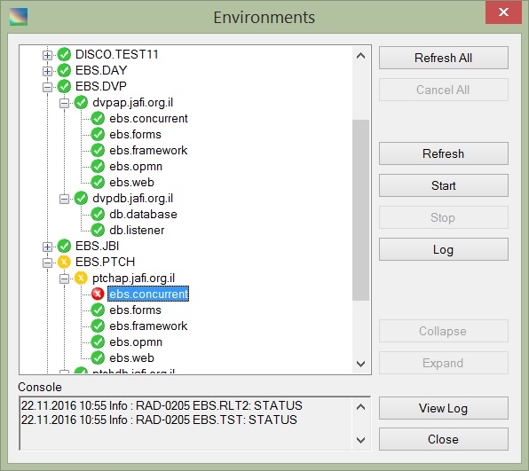
The environment’s status
Check that all services are functioning properly.
It’s a matter of just one click…

Slide 24
Conclusion

Slide 25

Raduga gives you easy, intuitive navigation between
Environments
Projects
Paths
Applications
Languages
Entities

Slide 26

Migrate applications, database objects and programs.
Create your own rules for migrating custom objects.
The deployment process has never been so easy!

Slide 27

Get full control over the development life cycle.
Easily save, restore, update and compare objects.

Slide 28
Raduga gives managers and team members
A clear development model
Source control
Flexible reporting

Slide 29
Contact us:
Web: http://LazyDeploy.com
Email: support@LazyDeploy.com
Tel: +79185402272

Slide 30
Thank you

